Slide 1
Validation methods & Performance metrics
Lecture 6
MAL1, 2025

Slide 2
The big picture
Data
Model
Performance

Slide 3
The big picture
Train data
Model
Test accuracy
Test data
Train accuracy

Slide 4
Validation Methods and performance metrics
Validation methods
Performance metrics

Slide 5
Validation methods
Train data
Train data
Test data
Validation data
Test data
Train-test methodology
Train-val-test methodology
Train data
Train data
Train data
Validation data
Train data
Test data
Train data
Test data
Train data
Test data
Train data
Test data
Validation data
Test data
Train data
Test data
Train data
Train data
Test data
Validation data
Test data
Test data
Test data
Cross-validation methodology
Leave-1-out cross validation methodology

Slide 6
Train-test methodology
Train data
Validation data
Test data
Train-val-test methodology
Tune hyperparameters
Train data
Machine learning algorithm
Trained model
Test accuracy
Test data
Train accuracy
Final model
Train data
Train data
Train data
Test data
Train data
Test data
Train data
Test data
Train data
Test data
Train data
Test data
Test data
Test data
Train-test methodology
Leave-1-out cross validation methodology
Train data
Validation data
Test data
Train data
Validation data
Test data
Train data
Validation data
Test data
Cross-validation methodology

Slide 7
Train-val-test methodology
Tune hyperparameters
Train data
Test data
Train-val-test methodology
Tune hyperparameters
Test accuracy
Train data
Machine learning algorithm
Trained model
Validation accuracy
Validation data
Test data
Train accuracy
Test accuracy
Train data
Validation data
Test data
Train data
Validation data
Test data
Final model
Final model

Slide 8
Cross-validation methodology
Tune hyperparameters
Train data
Validation data
Test data
Train data
Validation data
Test data
Machine learning algorithm
Trained model
Avg. validation accuracy
Train data
Validation data
Test data
Train accuracy
Test accuracy
Final model

Slide 9
Cross-validation methodology

Slide 10
Leave-1-out Cross-validation methodology
Tune hyperparameters
Train data
Train data
Train data
Test data
Train data
Test data
Train data
Test data
Train data
Test data
Train data
Test data
Machine learning algorithm
Trained model
Avg. validation ”accuracy”
Test data
Test data
Train accuracy
Test accuracy
Final model

Slide 11

Code Example
Jupyter Notebook Validation methods

Slide 12
A note on preprocessing
Deal with outliers
Deal with missing values
Normalize/scale data
One-hot encoding
Representing text data
…

Slide 13
A note on preprocessing
Ideally you should isolate you testing data before you do anything else! That means only doing data cleaning and feature engineering on training and validation data.
Tune hyperparameters
Train data
Machine learning algorithm
Trained model
Validation accuracy
Validation data
Test data
Train accuracy
Test accuracy
Final model

Slide 14
A note on preprocessing
But often this is quite impractical. So for simplicity, we will often do data preparation on all data, and separate the test data after that!
Tune hyperparameters
Train data
Machine learning algorithm
Trained model
Validation accuracy
Validation data
Test data
Train accuracy
Test accuracy
Final model

Slide 15
Validation Methods and performance metrics
Validation methods
Performance metrics

Slide 16
The big picture
Train data
Model
Test accuracy
Test data
Train accuracy

Slide 17
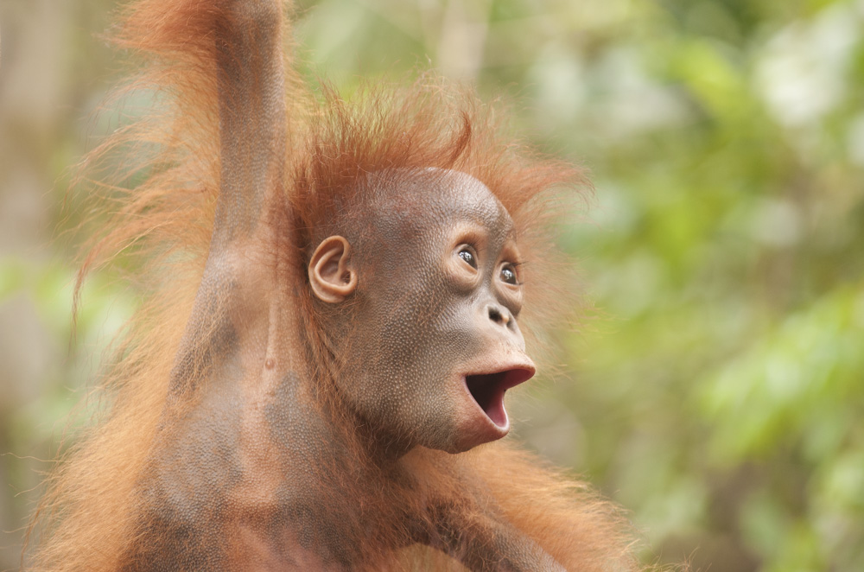
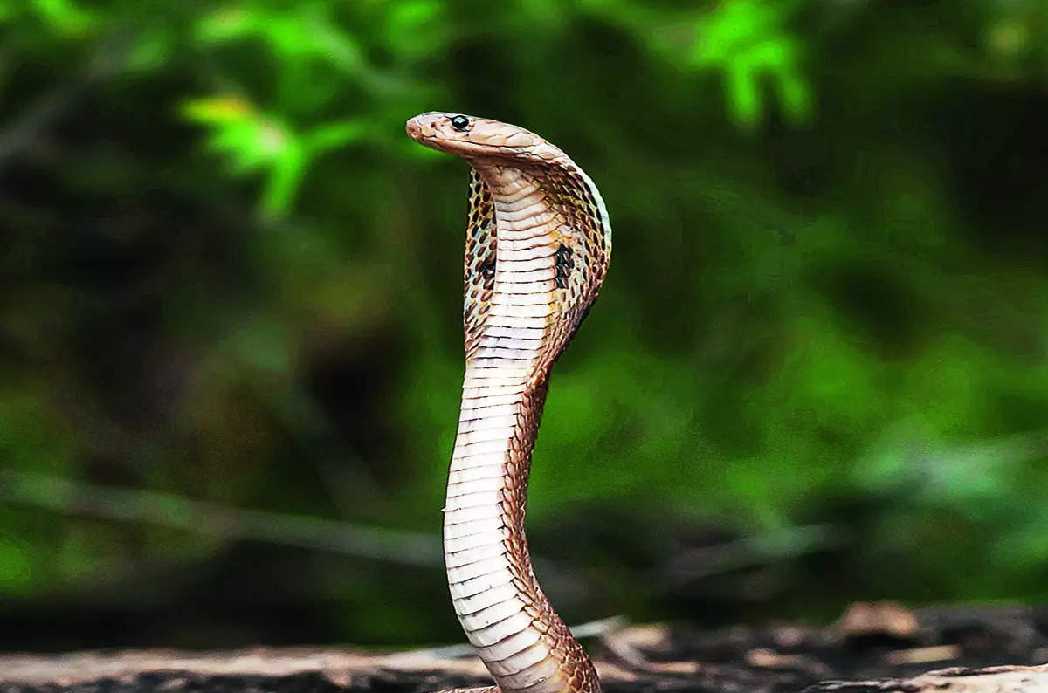
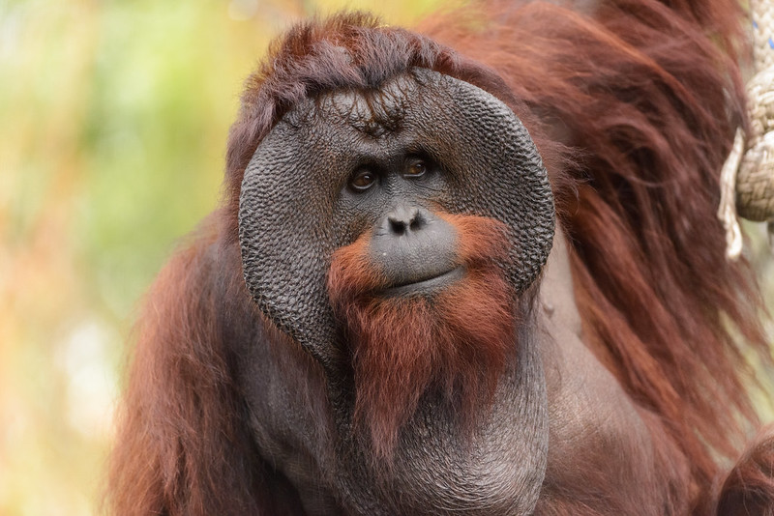
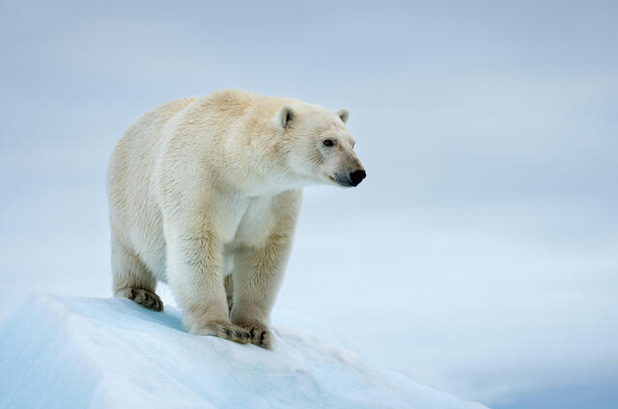
Types of errors
”This is an orangutan”
”This is an orangutan”
”This is not an orangutan”
”This is not an orangutan”

Slide 18
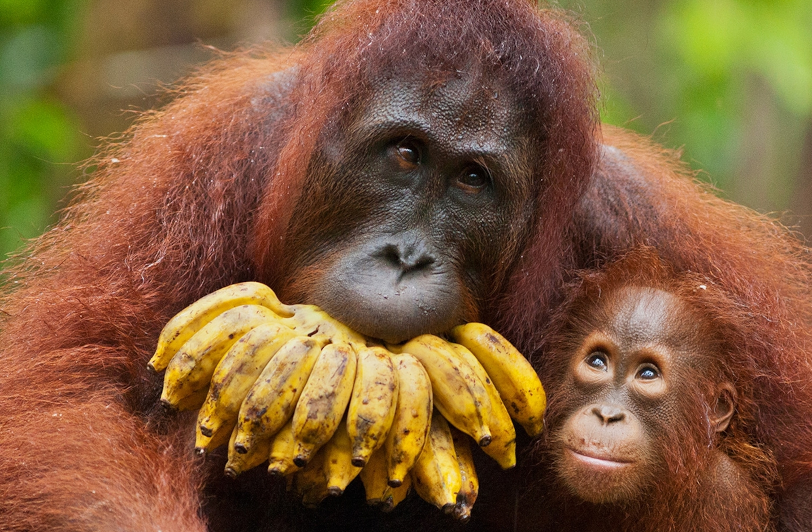
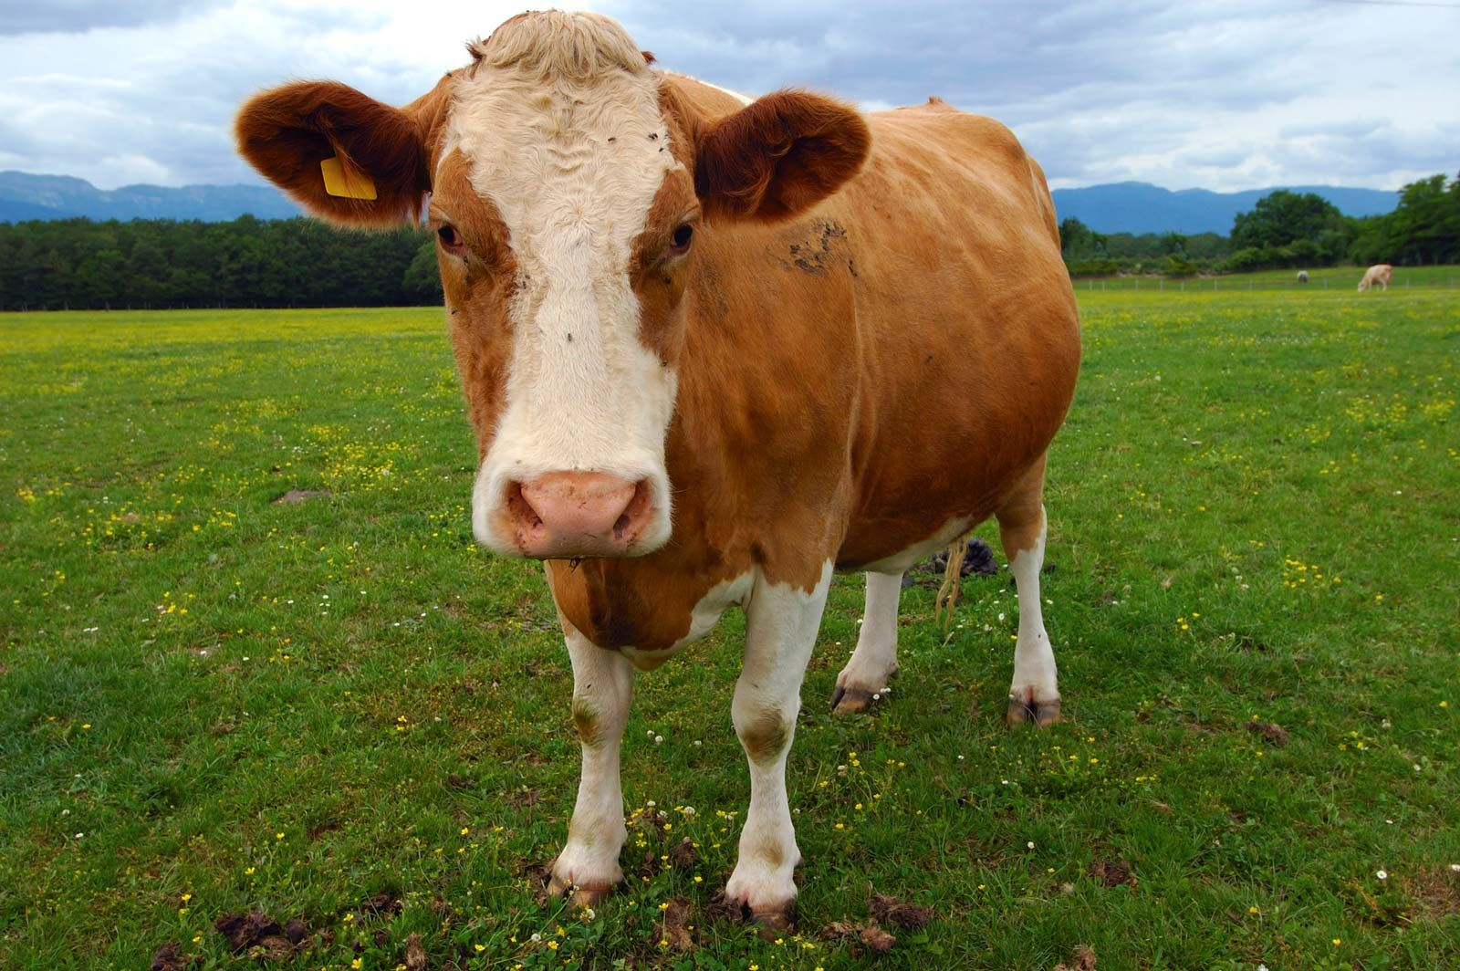
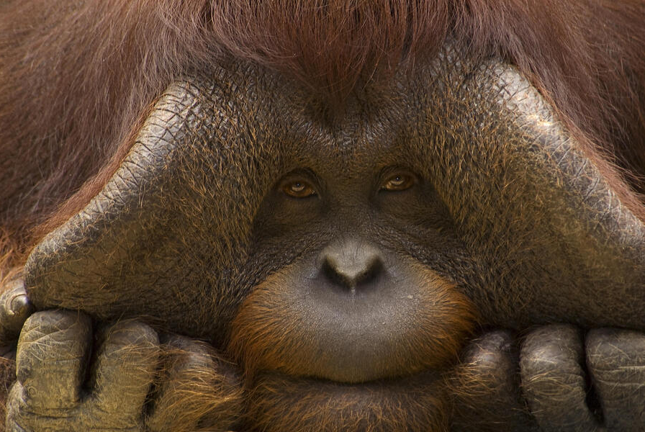
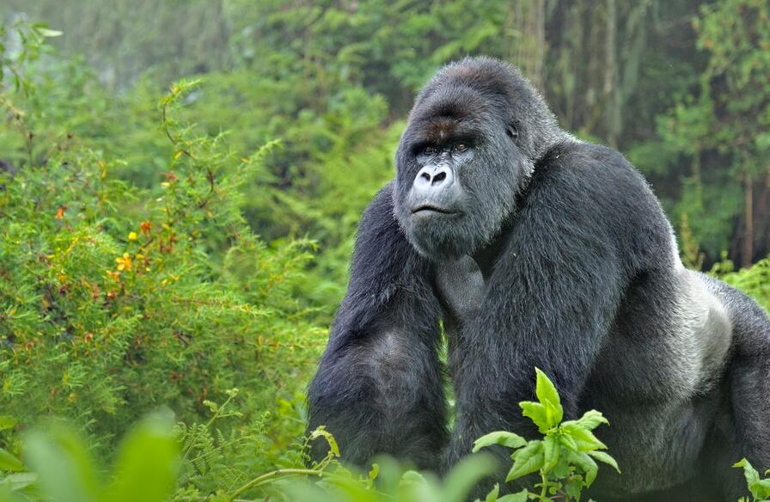
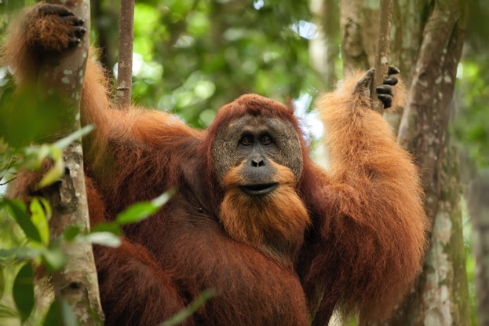
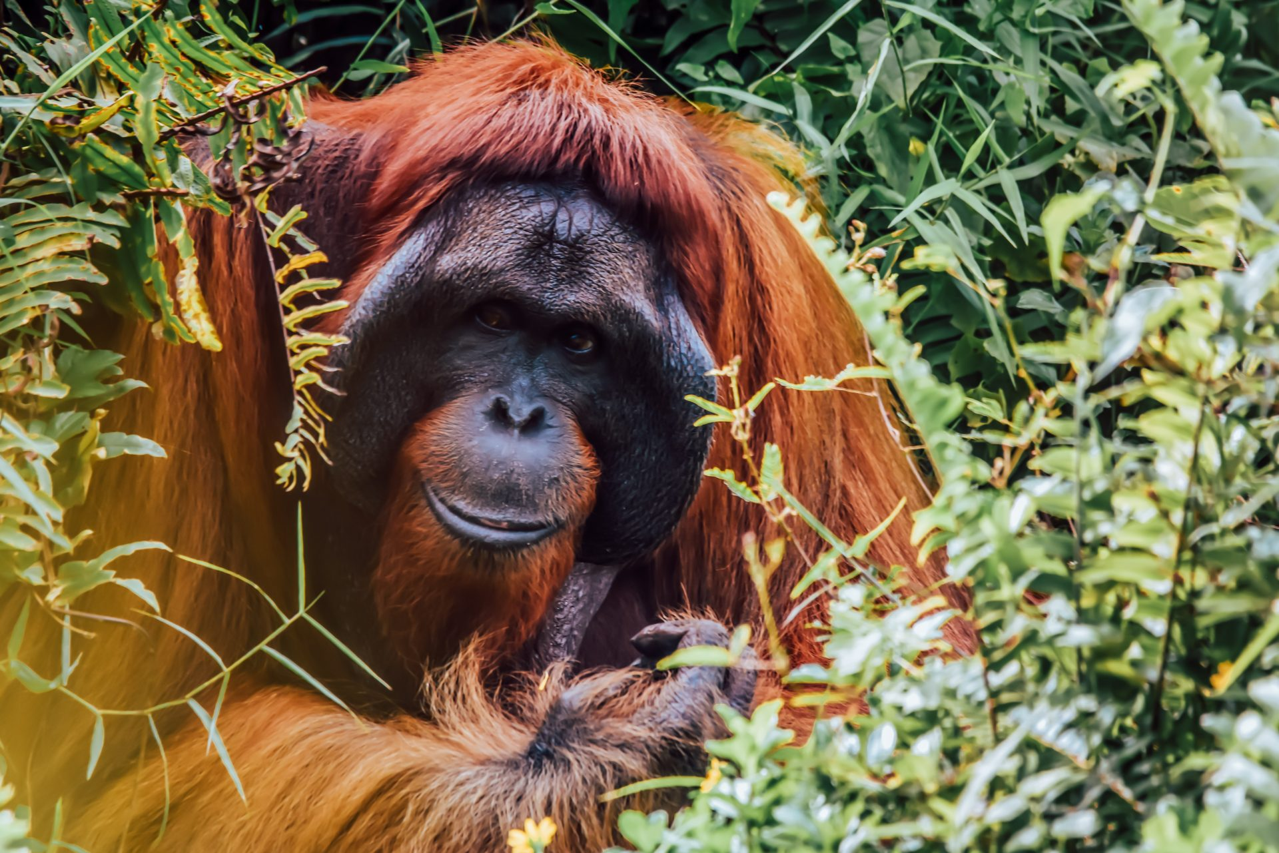
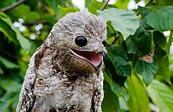
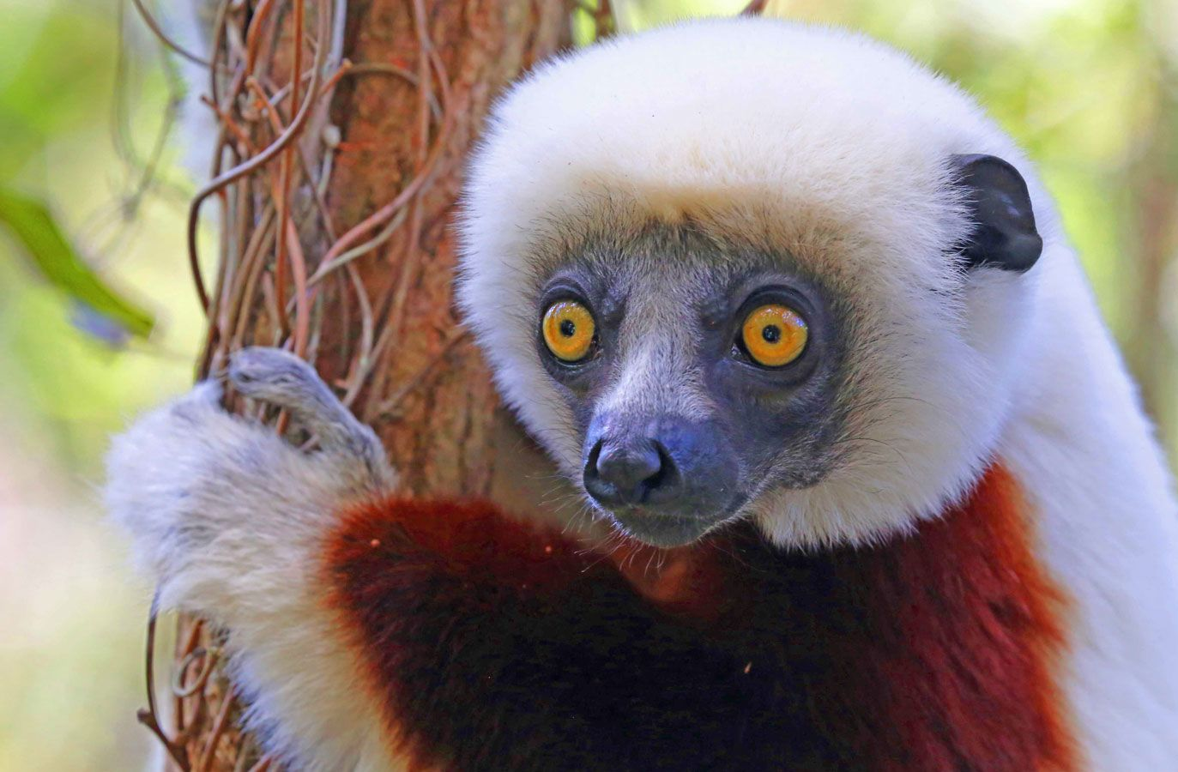
Types of errors
true class
positive
negative
TRUE
POSITIVE
FALSE
POSITIVE
positive
”This is an orangutan”
”This is an orangutan”
predicted class
FALSE
NEGATIVE
TRUE
NEGATIVE
negative
”This is not an orangutan”
”This is not an orangutan”

Slide 19
Types of errors
TP
FN
FP
TN
”orangutan”
”not orangutan”
”orangutan”
”not orangutan”
true class
positive
negative
positive
TRUE
POSITIVE
FALSE
POSITIVE
”orangutan”
”not orangutan”
”orangutan”
”orangutan”
predicted class
FALSE
NEGATIVE
TRUE
NEGATIVE
negative
”orangutan”
”not orangutan”
”not orangutan”
”orangutan”

Slide 20
Types of errors
TP
FN
FP
TN
”orangutan”
”not orangutan”
”orangutan”
”not orangutan”
true class
positive
negative
TP
TN
FP
TP
positive
TP = 5
FP = 2
”orangutan”
”not orangutan”
”orangutan”
”orangutan”
predicted class
TP
TN
TN
TP
negative
FN = 1
TN = 4
”orangutan”
”not orangutan”
”not orangutan”
”orangutan”

Slide 21
Accuracy
true class
positive
negative
positive
TP = 5
FP = 2
predicted class
negative
FN = 1
TN = 4

Slide 22
Why accuracy is not good enough
A model to predict whether or not someone is a terrorist:
Everyone is not a terrorist.
true class
positive
negative
positive
TP = 0
FP = 0
predicted class
negative
FN = 1
TN = 9999

Slide 23
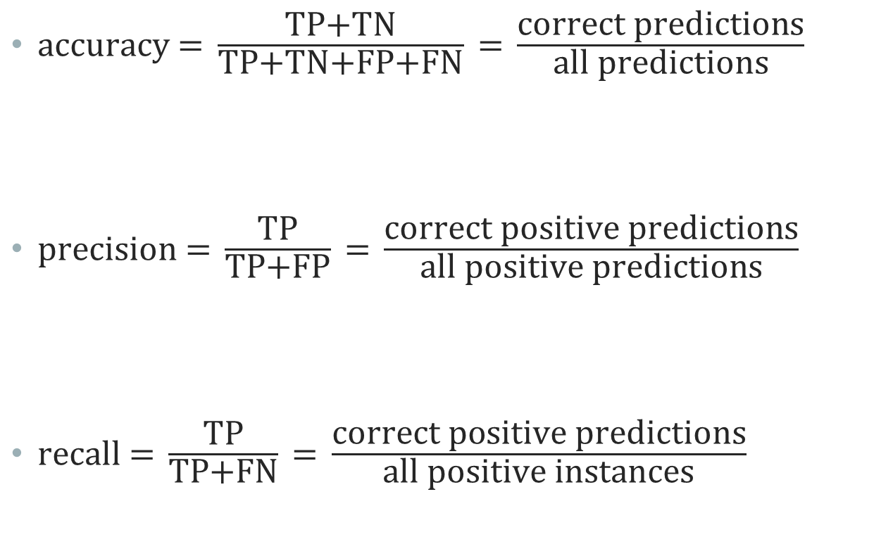
Performance metrics
$\text{accuracy}\text{ = }\frac{\text{TP}\text{+}\text{TN}}{\text{TP}\text{+}\text{TN}\text{+}\text{FP}\text{+}\text{FN}}\text{ = }\frac{\text{correct} \text{predictions}}{\text{all} \text{predictions}}$
$\text{precision}\text{ = }\frac{\text{TP}}{\text{TP}\text{+}\text{FP}}\text{ = }\frac{\text{correct} \text{positive} \text{predictions}}{\text{all} \text{positive} \text{predictions}}$
$\text{recall}\text{ = }\frac{\text{TP}}{\text{TP}\text{+}\text{FN}}\text{ = }\frac{\text{correct} \text{positive} \text{predictions}}{\text{all} \text{positive} \text{instances}}$

Slide 24
Using recall instead
A model to predict whether or not someone is a terrorist:
Everyone is not a terrorist.
true class
positive
negative
positive
TP = 0
FP = 0
predicted class
negative
FN = 1
TN = 9999

Slide 25
Some examples
Determine whether someone is a terrorist
avoid false negatives – use recall!
Determine whether you have COVID-19 during the pandemic
Determine whether a video is suitable for children to watch
Determine whether someone should be sentenced to life in prison
To optimize hyperparameters on a particular metric:
GridSearchCV(clf, parameters, scoring="recall")
GridSearchCV(clf, parameters, scoring="precision")

Slide 26

The precision/Recall trade-off
High recall usually means low precision – and vice versa
propability of
orangutan
$$\text{precision}\text{ = }\frac{\text{TP}}{\text{TP}\text{+}\text{FP}} \text{recall}\text{ = }\frac{\text{TP}}{\text{TP}\text{+}\text{FN}}$$

Slide 27

The precision/Recall trade-off
High recall usually means low precision – and vice versa
$$\text{precision}\text{ = }\frac{\text{TP}}{\text{TP}\text{+}\text{FP}} \text{recall}\text{ = }\frac{\text{TP}}{\text{TP}\text{+}\text{FN}}$$
propability of
orangutan

Slide 28

The precision-Recall Curve
$$\text{precision}\text{ = }\frac{\text{TP}}{\text{TP}\text{+}\text{FP}} \text{recall}\text{ = }\frac{\text{TP}}{\text{TP}\text{+}\text{FN}}$$
High recall usually means low precision – and vice versa
1
precision
0
0
recall
1

Slide 29
Code Example
Jupyter Notebook Performance metrics

Slide 30
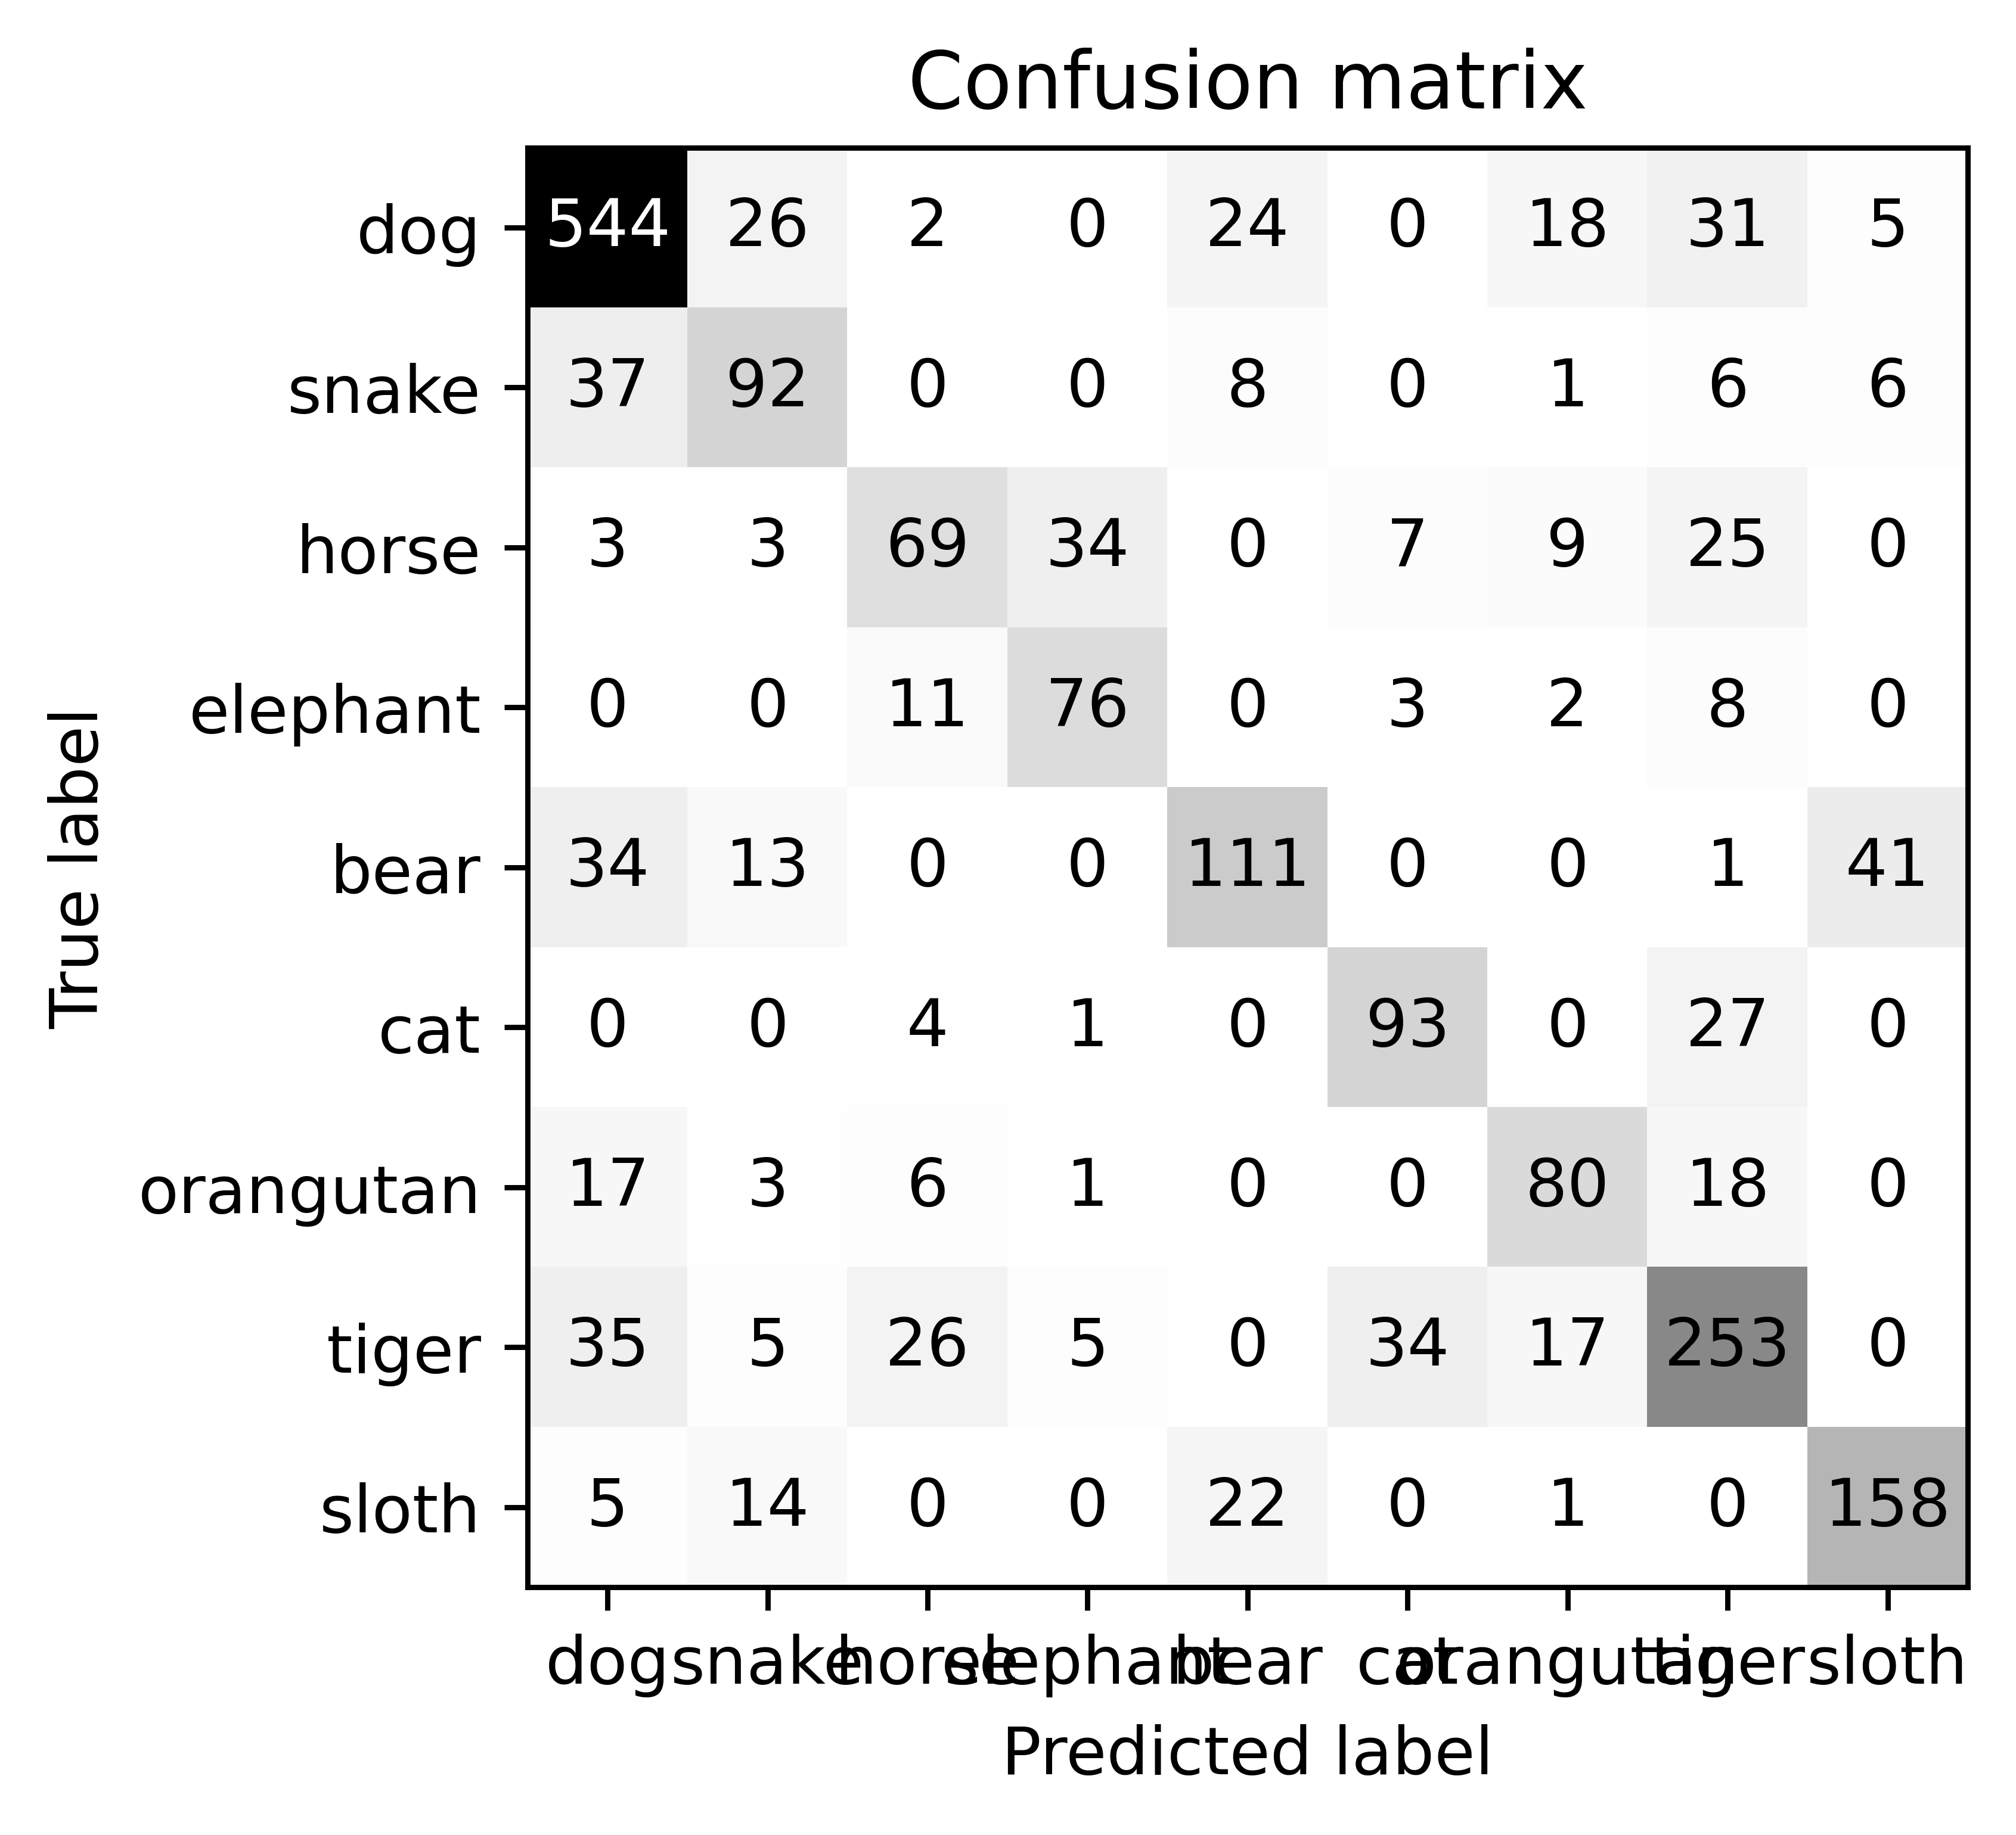
Metrics in multiclass problems
You can calculate all metrics for all classes, but

